Slide 1
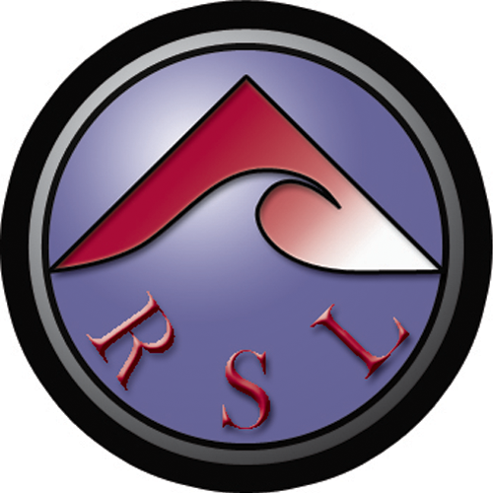

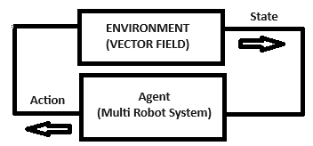
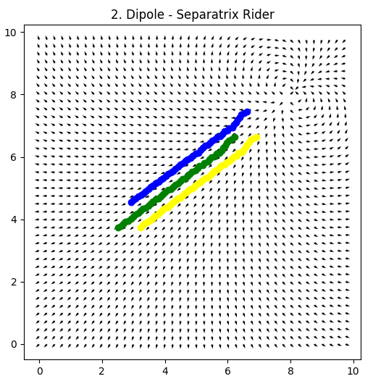
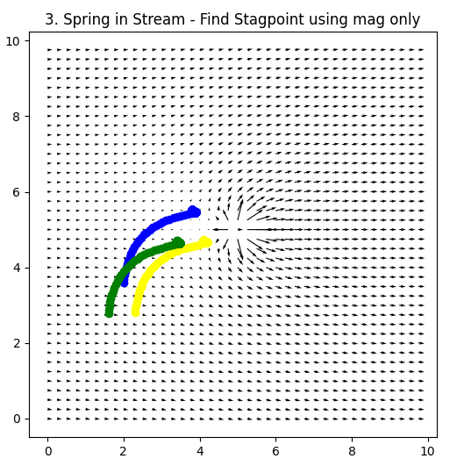
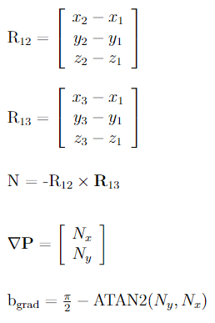
Centralized Control Primitives for Multi-Robot Navigation in 2D Vector Fields
Christopher Waight
Advisor: Dr. Christopher Kitts
Abstract
Background
Control Architecture
This poster presents an innovative approach for modelling composite vector fields and identifies regions of interests in 2D vector field environments.
It reviews previously established control primitives for multirobot systems and introduces newly designed primitives for navigation to these regions of interest including extrema, stagnation points, and separatrix features.
These primitives are verified using simulation on vector field environments modelled using the innovative approach.
Previous work at SCU identified that basis vector fields can be superimposed to model more complex vector fields. It was also identified that extrema seeking, and extrema orbiting can be done by treating vector information as scalar information. Examples of primitives using only magnitude information, and primitives using only direction information were shown. This work uses the ‘vector to scalar’ approach and other approaches to develop primitives for more vector field regions of interest.
Markov Property - The decision on which direction the multirobot system (agent) travels in (action) relies solely on instantaneous information from the vector field (environment).
Basis Vector Fields
Navigation to ROI’s
Uniform Flow – in either x or y direction
Vortex – free, fixed, Rankine vortices
Sinks/Sources – each individually
Dipole – A sink and source almost co-located
Fig 4: Multirobot System in a Reactive Loop
Centralized Architecture – All robots have access to sensor readings from all other robots.
Applications
Regions of Interest
Centre – Vortices, Sinking Vortices, Sources
Equal magnitude Line – Sinks, Vortices, Dipoles
Stagnation Points – Vortex or spring in Stream
Separatrix – spring or vortex in stream, dipole
Fastest Flow – Rankine Vortex (Hurricane Wall)
Conclusion
These findings potentially enhance autonomous navigation in complex vector field environments. These are particularly useful when human exploration is dangerous or impossible:
Environmental monitoring
Disaster Response
Navigating Complex Fluid Flows
Extraterrestrial Exploration
Multirobot systems also offer advantages such as redundancy, expanded coverage, and potential collaboration.
Established fully reactive control primitives to navigate to key regions in 2D vector fields using multirobot systems in a simulated environment.
Fig 2: Navigation along the Separatrix
Future Work
Extend work to 3D vector fields.
Test control primitives in real life on a physical test bed.
Investigate the relationships between formation, number of robots, and navigation performance.
cwaight@scu.edu / 650-388-0201
Fig 1: Normal Vector to Robotic Plane
Fig 3: Navigation to stagnation Point

